Slide 1
AMAN MOKHADE
RIGHT HAND BATSMAN
VIDARBHA SENIOR MEN’S TEAM
IN RANJI TROPHY SEASON 25-26

Slide 2
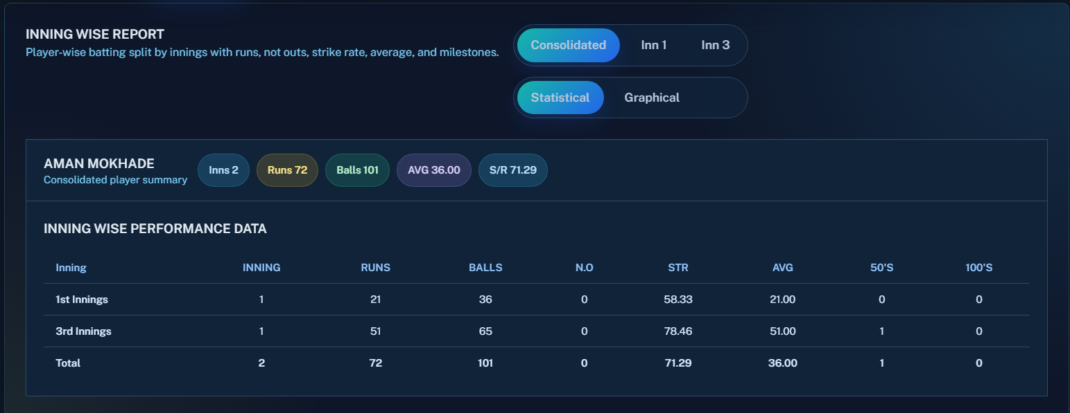
ROUND – 6 vs ANDHRA AT ANANTPUR.
BATTING STATS

Slide 3
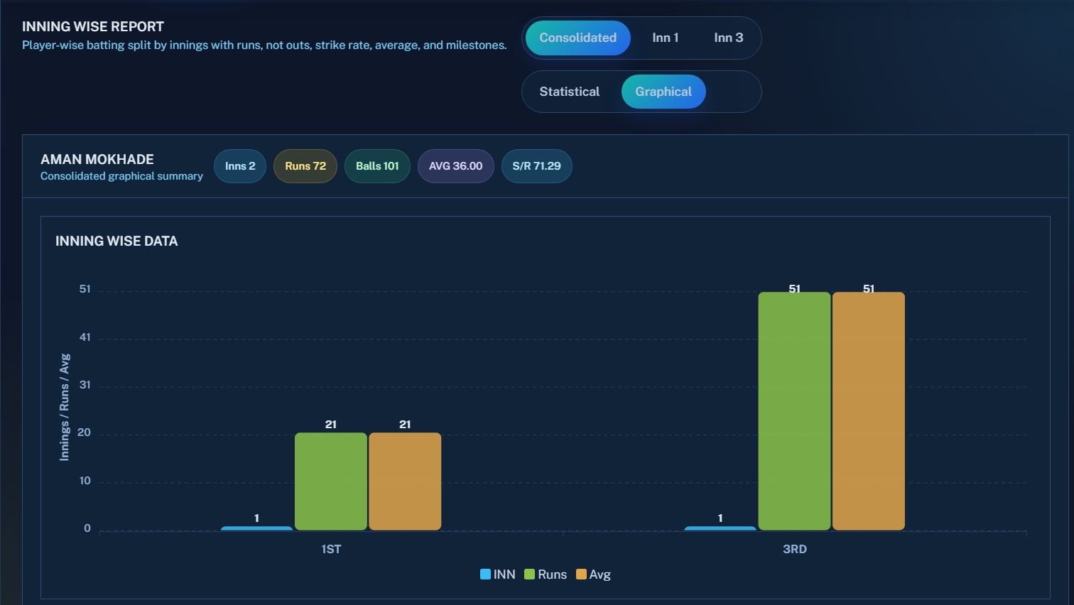
ROUND – 6 vs ANDHRA AT ANANTPUR.
BATTING STATS GRAPHICAL REPRESENTATION

Slide 4
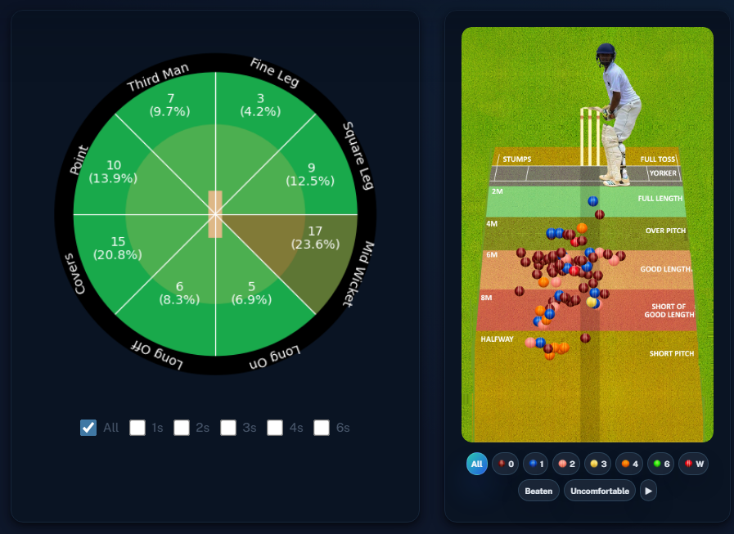
ROUND – 6 vs ANDHRA AT ANANTPUR.
OVER ALL

Slide 5
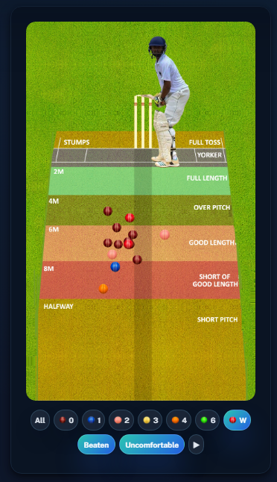
ROUND – 6 vs ANDHRA AT ANANTPUR.
BEATEN , UNCOMFORTABLE & DISMISSAL AREAS

Slide 6
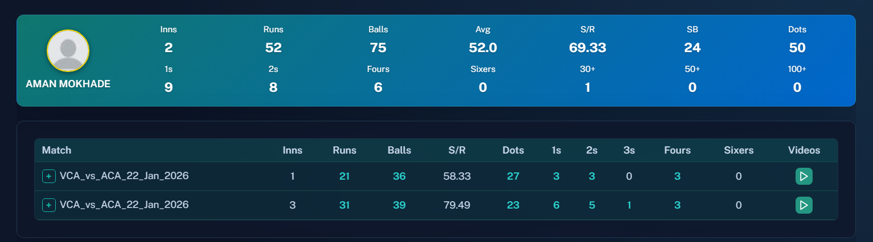
ROUND – 6 vs ANDHRA AT ANANTPUR.
PHASE WISE – ( 1 TO 20 OVERS )

Slide 7
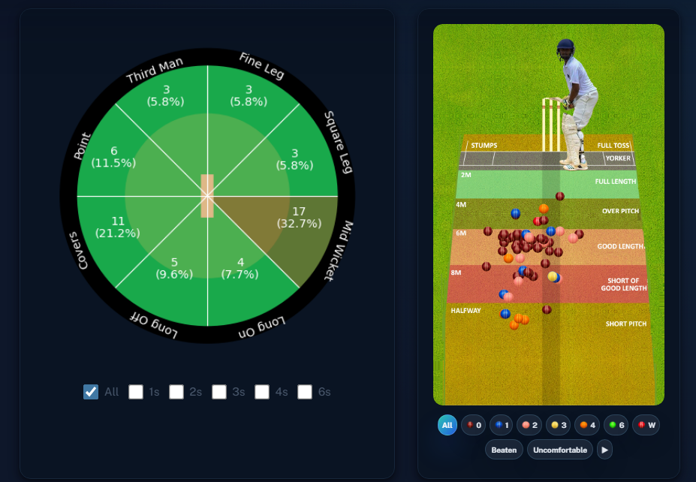
ROUND – 6 vs ANDHRA AT ANANTPUR.
PHASE WISE – ( 1 TO 20 OVERS )

Slide 8
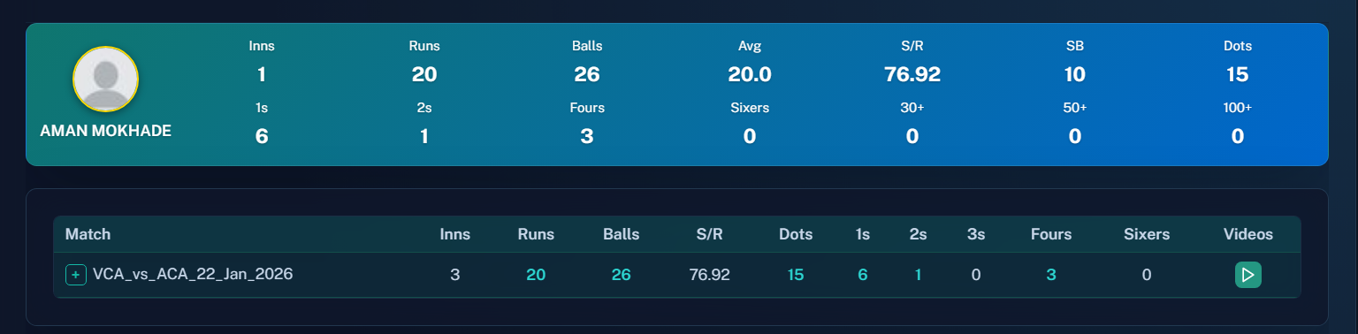
ROUND – 6 vs ANDHRA AT ANANTPUR.
PHASE WISE – ( 21 TO 50 OVERS )

Slide 9
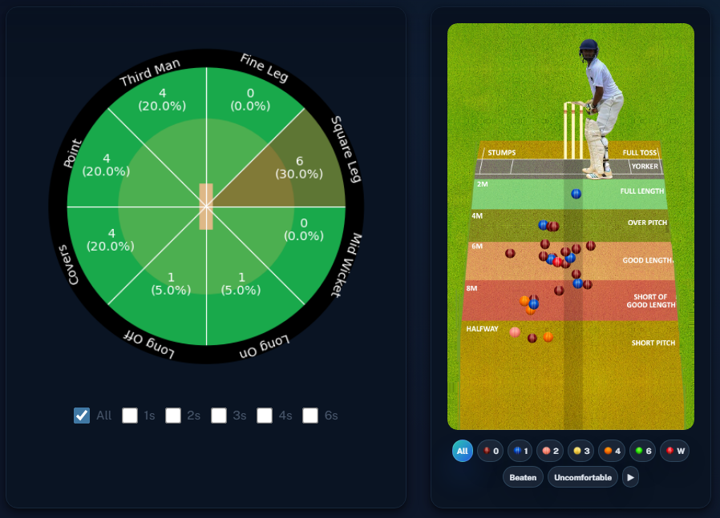
ROUND – 6 vs ANDHRA AT ANANTPUR.
PHASE WISE – ( 21 TO 50 OVERS )

Slide 10
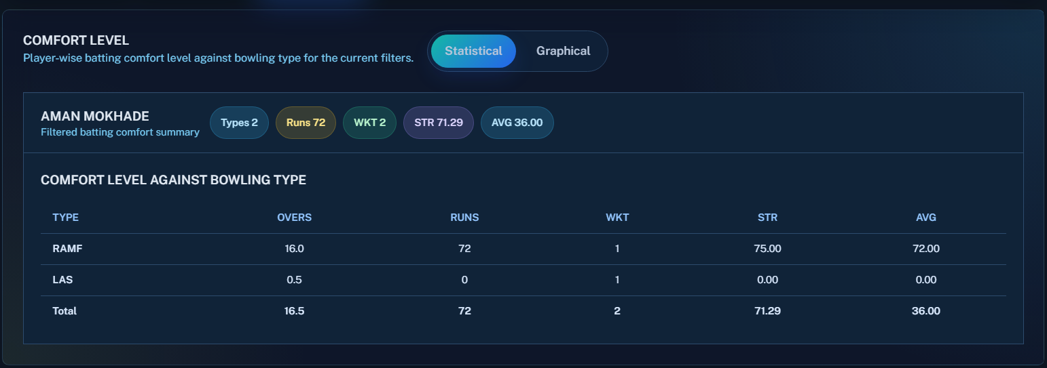
ROUND – 6 vs ANDHRA AT ANANTPUR.
COMFORT LEVEL REPORT

Slide 11
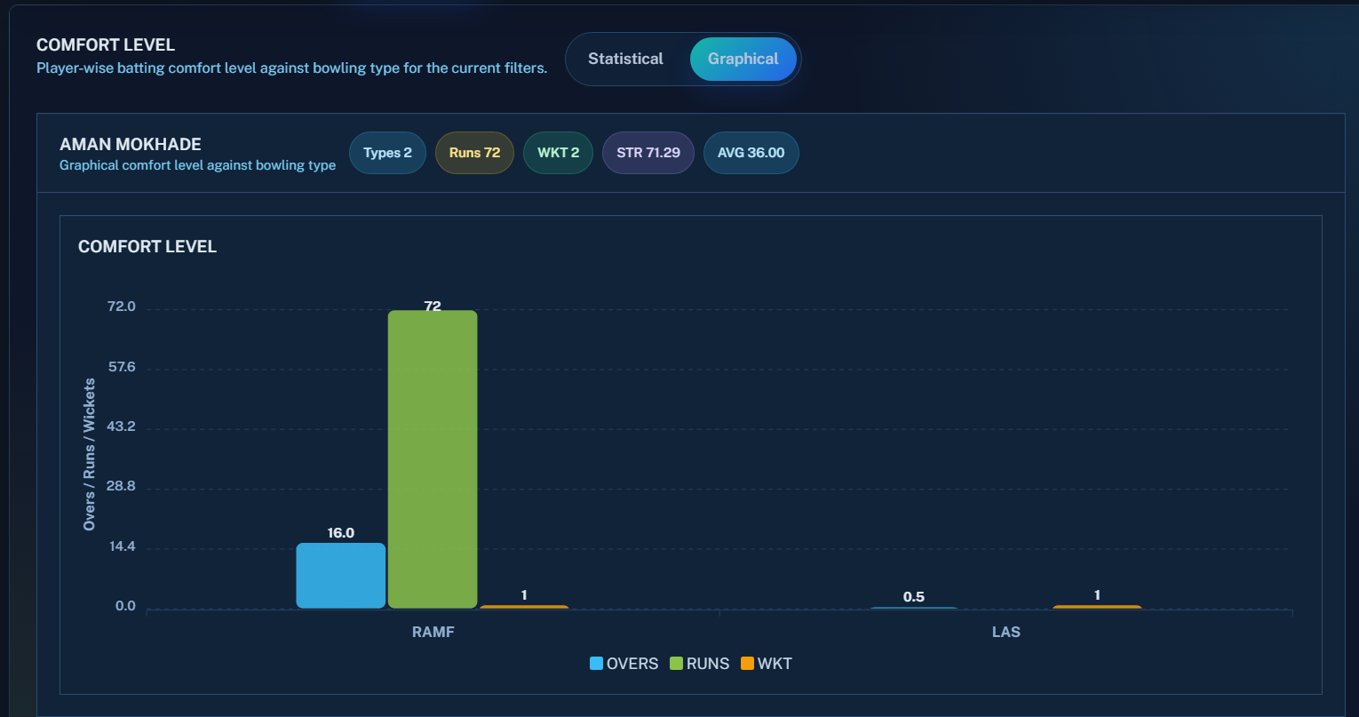
ROUND – 6 vs ANDHRA AT ANANTPUR.
COMFORT LEVEL REPORT - GRAPHICAL

